Slide 1
Cancer
Control
Alberta
Dr. Linda Watson, RN, PhD, CON(C)
Scientific Director, Applied Research and Patient Experience
CancerControl, Alberta Health Services

Slide 2
The Reality of Cancer in Alberta
180,000 Albertans currently living with and beyond cancer.
Over 17,000 new diagnosis of cancer in Alberta every year
Last year CCA had:
25,000 consults
82,152 systemic treatment visits
126,817 RT treatment visits
Over 32,000 (or 40%) of those treatment visits involved patients who were receiving non-curative treatments for their cancer (advanced cancer patients)
All cancer patients need some level of symptom management support, with advance cancer patients requiring more complex supports

Slide 3
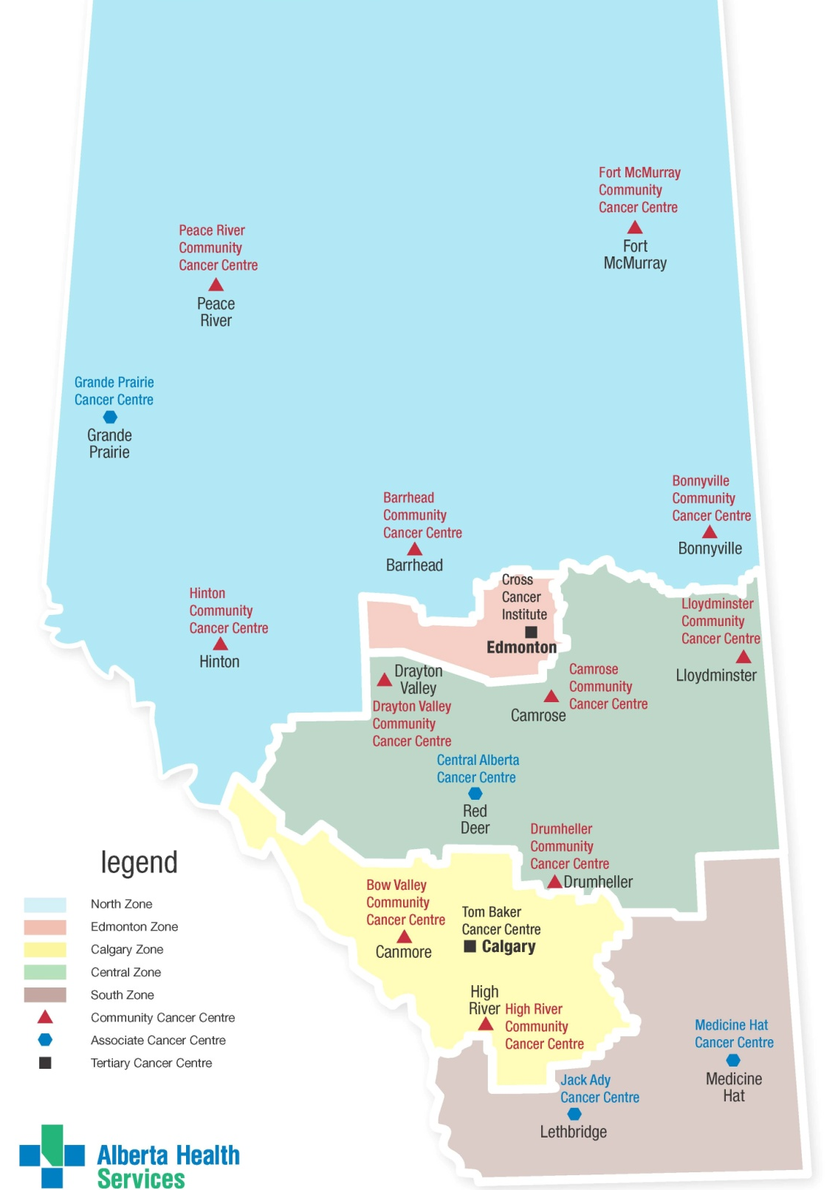
Ambulatory Cancer Services in Alberta
One Health Region – Alberta Health Services
CancerControl Alberta (CCA) is a provincial program in AHS
CCA has 17 ambulatory cancer care facilities
Two Large Tertiary Cancer Centres
Tom Baker Cancer Centre (Calgary)
Cross Cancer Institute (Edmonton)
Four Regional Cancer Centres
Grand Prairie Cancer Centre
Central Alberta Cancer Centre (Red Deer)
Jack Ady Cancer Centre (Lethbridge)
Margery E. Yuill Cancer Centre (Medicine Hat)
11 small community infusion clinics distributed across rural communities

Slide 4
Balancing the General and the Unique
Everyone needs diagnosis, treatment options, and timely access to evidence based care
Everyone has unique personal elements that impact their ability to cope
Some things facilitate effective coping, while others do not. The negative items if unmitigated can cause Distress
NCCN, 2010

Slide 5
distress is not a constant, nor is the cancer experience
Diagnosis
Treatment
Post-Treatment
Reoccurrence
Remission
Howell & Olsen, 2011

Slide 6
The Goal: A Person Centred Experience
My care was tailored to who I am and what’s important to me
My care enabled me to self manage when possible while ensuring I knew where to get help when needed
My care was coordinated across time and meet my changing needs
I was always treated with dignity, respect and compassion
I received timely
access to evidence informed cancer treatment
NHS, 2014

Slide 7
How to Enable A Person Centred Experience
Person centred clinician
Informed, activated patient/family
Accessible, well organized healthcare system
Improved communication and outcomes
Epstein & Street, 2007
Notes:
Linda

Slide 8
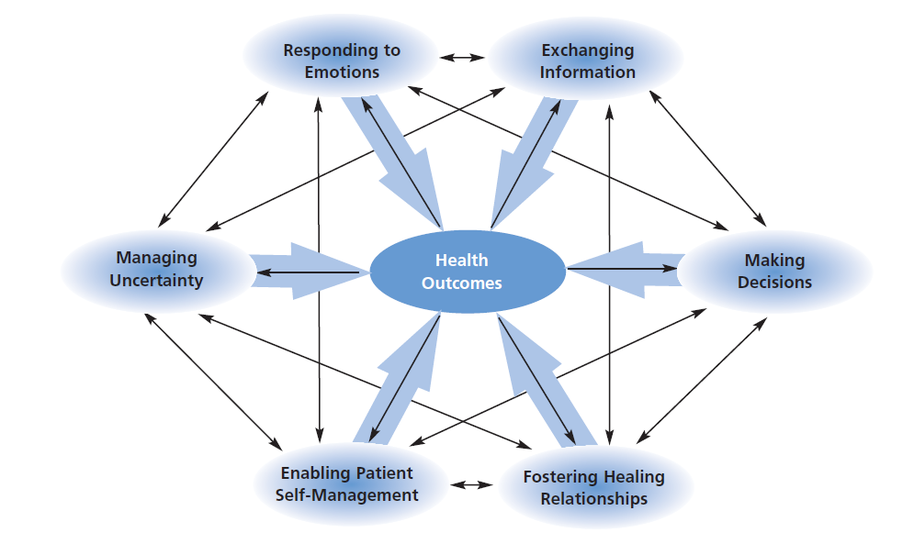
Essential Component: Person Centred Communication
Epstein & Street, 2007

Slide 9
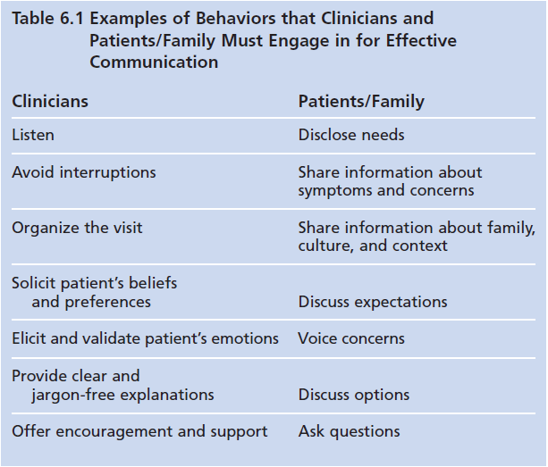
Clinician Communication behaviours
Patient/Family Communication
behaviors
Activated Patient
Patient Centred Clinician
Epstein & Street, 2007

Slide 10
What ARE Patient Reported Outcomes?
Reported directly by patients
Complement but do not duplicate clinical outcome measures
Measures things that affect the patients Quality of Life
Can be collected on paper or electronically

Slide 11
Patient Reported Outcomes: An Important Tool
Offer the healthcare provider a window into each unique patient experience
Can be used to understand how a unique patient’s care needs change over time
Can be used as a communication tool to talk about what matter’s to the patient
Can drive efficiencies in the clinic by targeting clinical attention to the most pressing concerns or symptoms
Shows respect for the unique patient and allows an informed compassionate approach to care
Notes:
Linda

Slide 12
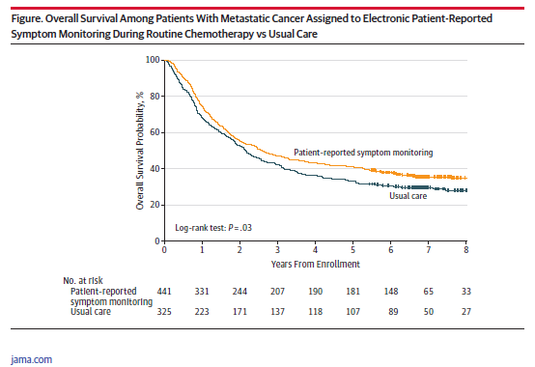
Improve Symptom Management and Clinical Outcomes
Basch et al, 2016

Slide 13
Patient Reported Outcomes: A Key Driver
Completing a patient report measure alone will not contribute to more patients having a person centred experience or improved health outcomes
The following process completed with each patient will contribute to more patient centred care experiences
Patient completes symptom screening tool (PRO measure)
Conversation occurs between patient and staff to identify most troubling concern
Shared decision making between HCP and patient to identify most helpful intervention
Action taken – either self-management by patient or clinical intervention or referral by HCP
(Watson et al, 2016)

Slide 14
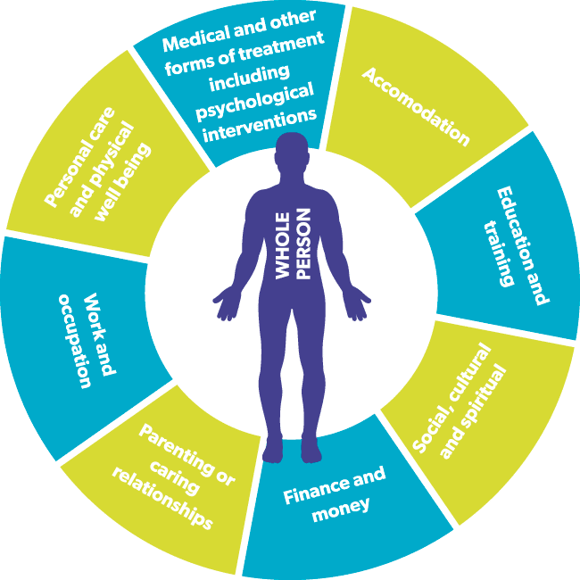
The Truth of It…
No matter how much knowledge a Healthcare Professional has about the disease and its treatments, they always must know something of the unique nuances of the individual in order to have the best outcomes

Slide 16
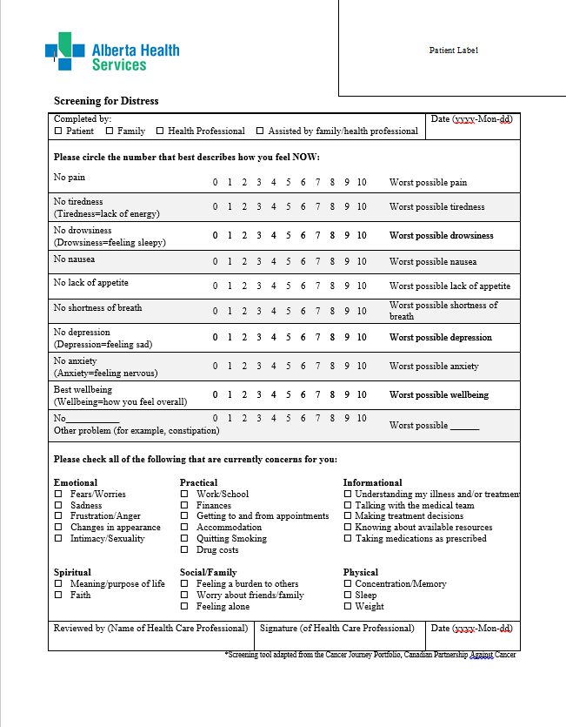
Collecting PROs in CCA
CPAC, 2012

Slide 17
https://www.youtube.com/watch?v=KFDyeS6n3e8&index=15&list=PLi1tOF1I5ZoUFt61X8KxkCGE4PYl92wNB

Slide 18
Enhancing the Impact by Improving Clinical Usability
Using Paper PRO tools CAN:
improve the clinical capacity to identify patients who are experiencing distress
be used to guide a person centred conversation which can improve patient outcomes
be used to triage patients who require further clinical support/interventions
Using Paper PRO tools CAN NOT:
Identify which symptoms have worsened since last visit
Quickly draw the clinician’s attention to areas of high symptom burden
Alert the clinical team of particularly challenging symptom clusters (when multiple symptoms happen at the same time intensifying the distress/complexity)
Flag the distressed patient to the appropriate team member based on the particular symptom cluster they are experiencing
Allow for tracking of a patient’s symptom burden across care locations/teams

Slide 19
Current Hybrid approach
Direct patient entry of PROs will occur in 2020 when new AHS wide EMR is implemented with a patient portal (Connect Care)
Notes:
Linda

Slide 20
Current status
Q1 2018-19
Unique patients who completed at least 1 PPF 17,465
Total number of PPFs completed 19,779
Q2 2018-19
Unique patients who completed at least 1 PPF 18,304
Q3 2018-19
Unique patients who completed at least 1 PPF 18,932
Total number of PPFs completed 20,823
Total number of PPFs completed 21,581
Q4 2018-19
Unique patients who completed at least 1 PPF 19,177
Total number of PPFs completed 21,863
CCI only site that is not currently using the hybrid
electronic entry approach with PROs

Slide 21
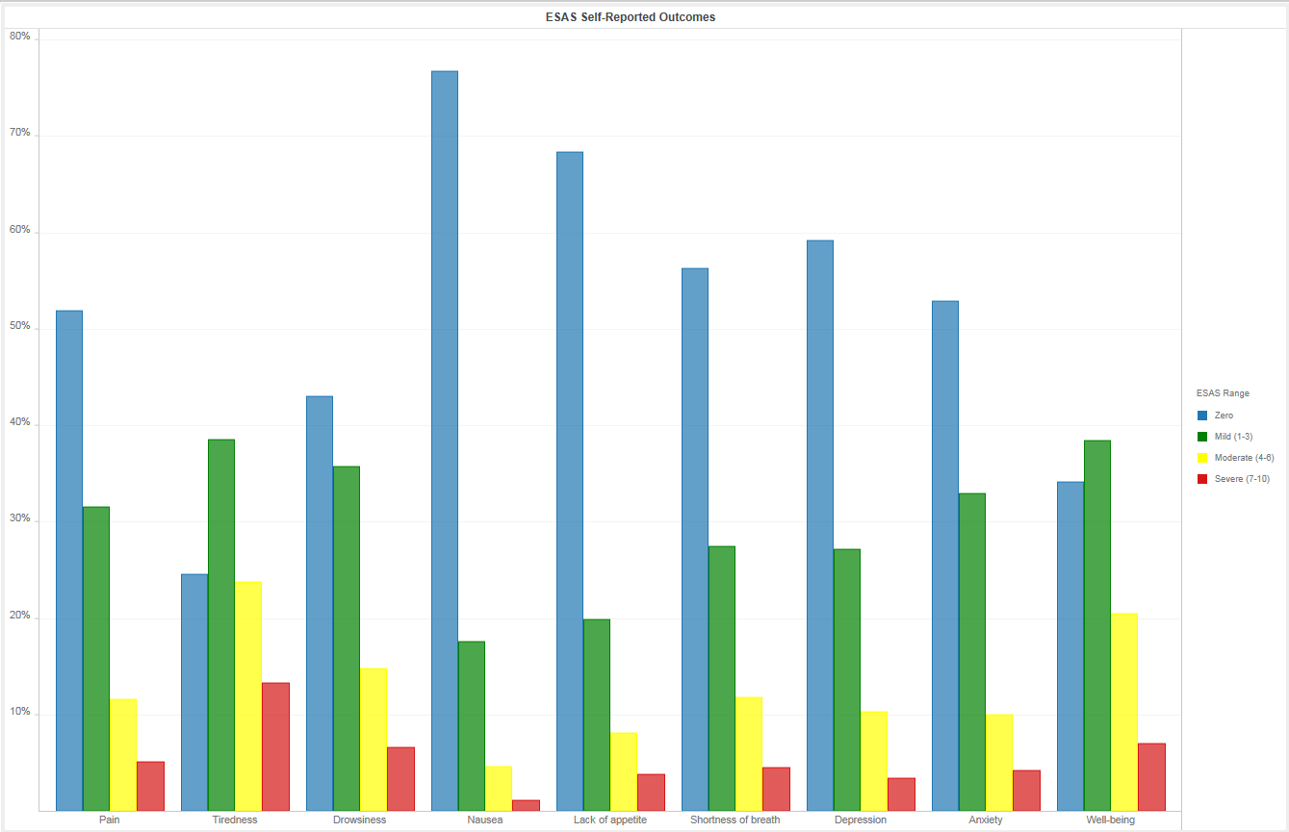
PRO trends: Prostate Patients in last Quarter
January 2019-March 31, 2019
1213 unique Prostate cancer
Patients completed at least 1 symptom screen
1323 unique symptom screens completed

Slide 22
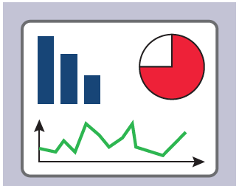
Current Hybrid approach
CLINIC LIST REPORT
1
INDIVIDUAL PATIENT
DASHBOARD WITH PATIENT FRIENDLY VERSION
2
Before Clinic
In Clinic
SYMPTOM CLUSTER REPORT(S)
After Clinic
3
Planning
4
AGGREGATE DASHBOARD
Direct patient entry of PROs will occur in 2020 when new AHS wide EMR is implemented with a patient portal
Notes:
Linda

Slide 23
Patient Reported Outcomes
Clinical Process
Before
Clinic
Care team review’s clinic list prior to clinic to identify patients who had high symptom complexity on last visit. They view individual dashboards as required

Slide 24
Clinic List Can be run by location, provider, date and time
PRE-CLINIC
1a
xxxxxxxx
xxxxxxxx
xxxxxxxx
xxxxxxxx

Slide 25
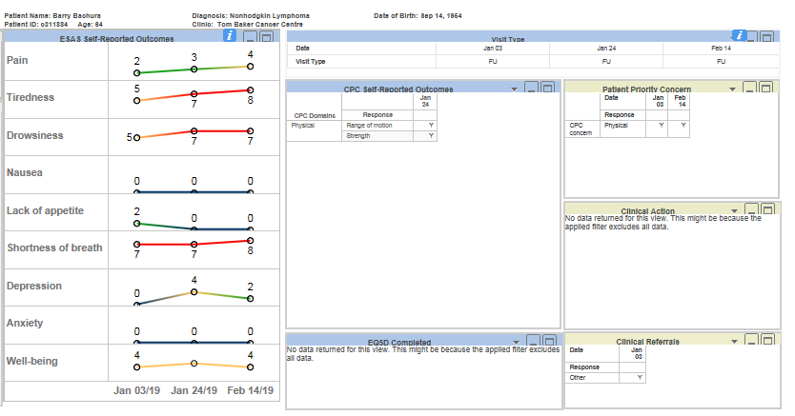
Individual PRO Trended Dashboard
1b
Pre-CLINIC

Slide 26
https://www.youtube.com/watch?v=3fCgwVHqs3I&index=13&list=PLi1tOF1I5ZoUFt61X8KxkCGE4PYl92wNB

Slide 27
Staff Feedback about Using The dashboard
Ability to view patient symptom history at a glace
Improved capacity for comparing patients current symptoms to concerns at previous clinic visits
Aids in identifying symptom trends and resulted in referrals to other disciplines
Shows patient complexity clearly
Can be used as a “teaching tool” to help patient see why they could benefit from a referral
Allows clinicians to quickly see when a referral has been made
Value add for the future –closed loop referrals

Slide 28
Clinical efficiencies: Capturing Symptom Distribution in Clinical Environments
60% Mild
25% Moderate
15%
Complex
Symptom Complexity Algorithm
Based on 700 chart audits in Tx clinics

Slide 29
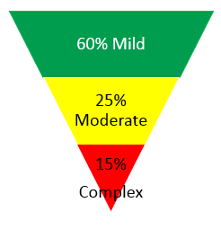
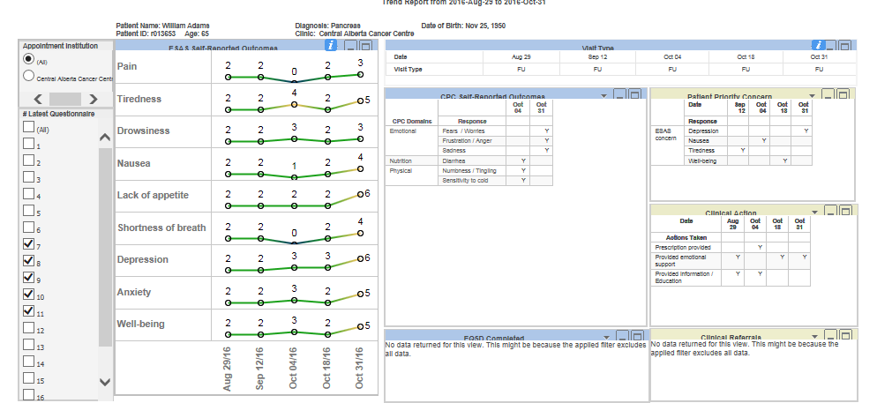
mild symptom complexity

Slide 30
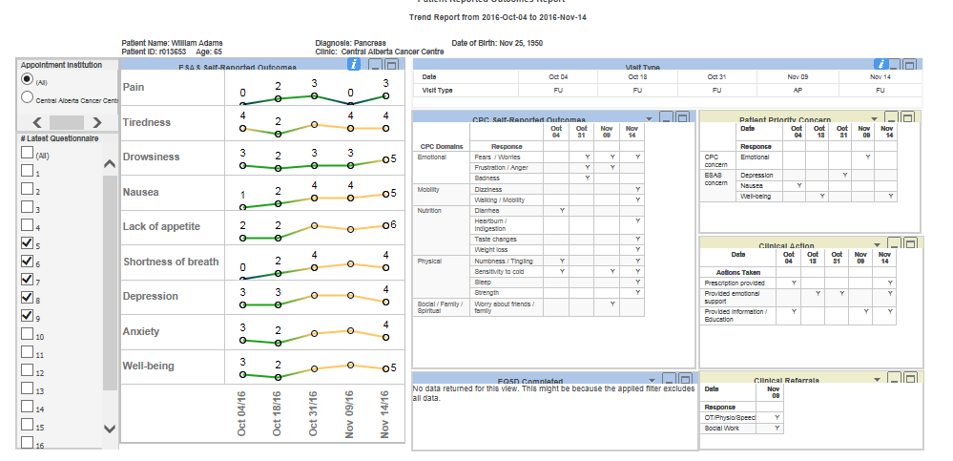
moderate symptom complexity

Slide 31
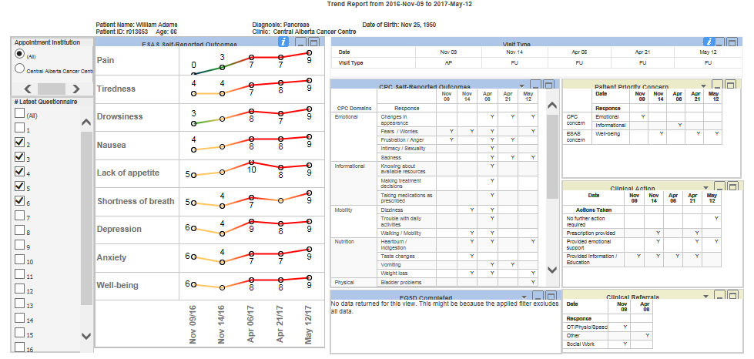
high symptom complexity

Slide 32
LOW SYMPTOM BURDEN GOOD BLOOD WORK NO SCANS TO REVIEW
AT HOME
PRE-CLINIC
VIRTUAL
CLINIC
APPOINTMENT
OR
ALTERNATE
MODERATE SYMPTOM BURDEN
PATIENT DIRECT
ENTRY OF PROS
AT HOME
CLINIC PREPARATION
PROS ARE REVIEWED
BY RN/ONCOLOGIST
ALONG SIDE OTHER
CLINICAL DATA (BLD WK,
TX CYCLE, CT SCANS)
SEE IN CLINIC AS SCHEDULED
HIGH SYMPTOM BURDEN
DISCUSS
SYMTPOM
MANAGEMENT
PLAN WITH TEAM PRIOR TO CLINIC VISIT
CLINIC OPTIMIZATION

Slide 33
Patient Reported Outcomes
Clinical Process
Before
Clinic
Care team review’s clinic list prior to clinic to identify patients who had high symptom complexity on last visit. They view individual dashboards as required
Patient receives print out of their trended symptom report at check in. Brings it into the clinic, where it is used as a conversation tool between patient and care team to identify areas where symptom management is required
In
Clinic

Slide 34
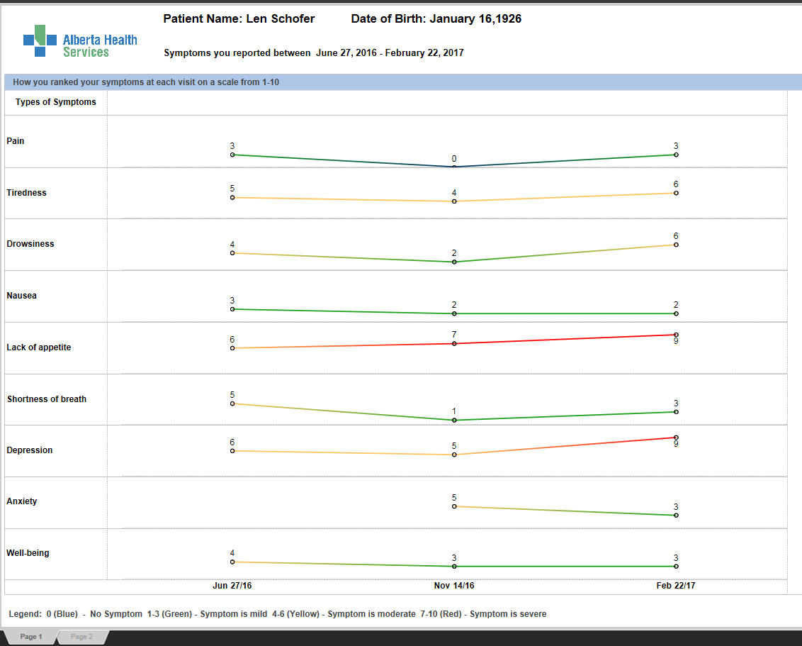
Your Symptom Tracking Report Patient friendly trended dashboard
2
IN-CLINIC

Slide 35
Patient Feedback about “Your Symptom Tracking Report”
Direct feedback was gathered from patients
Patients reported that the dashboard helped them:
Recognize how their concerns have changed over time
Identify where they need more help
talk to the healthcare team about symptoms they are having difficulty managing
Patients who got a follow up phone call (second phase of POC) found that very valuable
The majority of patients surveyed found the dashboard very helpful at home/after the clinic

Slide 36
Patient Reported Outcomes
Clinical Process
Before
Clinic
Care team review’s clinic list prior to clinic to identify patients who had high symptom complexity on last visit. They view individual dashboards as required
Patient receives print out of their trended symptom report at check in. Brings it into the clinic, where it is used as a conversation tool between patient and care team to identify areas where symptom management is required
In
Clinic
After
Clinic
Symptom management referrals made by clinic team can be made electronically with a single click. Allied health care team and visualize the individual patient symptom trends and other associated information

Slide 37
Outcomes
Improve patient experience
Improve symptom management
Improve clinical efficiencies

Slide 38
Discussion/Questions

